Slide 1

WPH Hospital
Proof of Concept Project
Group T11A-02:
Proteek Huq Z5416601
Kathleen Ong Z5421654
Hamza Khan Z5307203
Sy Anh Quoc Ho Z5307203

Slide 2
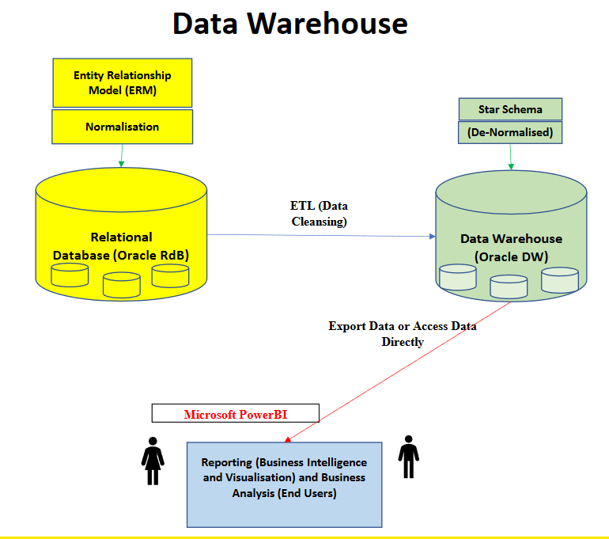

Requirement Analysis
WPH is a private hospital with a reputation for providing High Quality Healthcare services to its patients.
Team T11A-02 has created:
An Entity Relationship Diagram that effectively conveys the relationships between patients, staff members, and administrators.
A Relational Schema that efficiently captures data transfers that are necessary for providing high quality services.
A Materialized View that enables Data Analysis, that can be used to improve the efficiency & quality of operations.

Slide 3
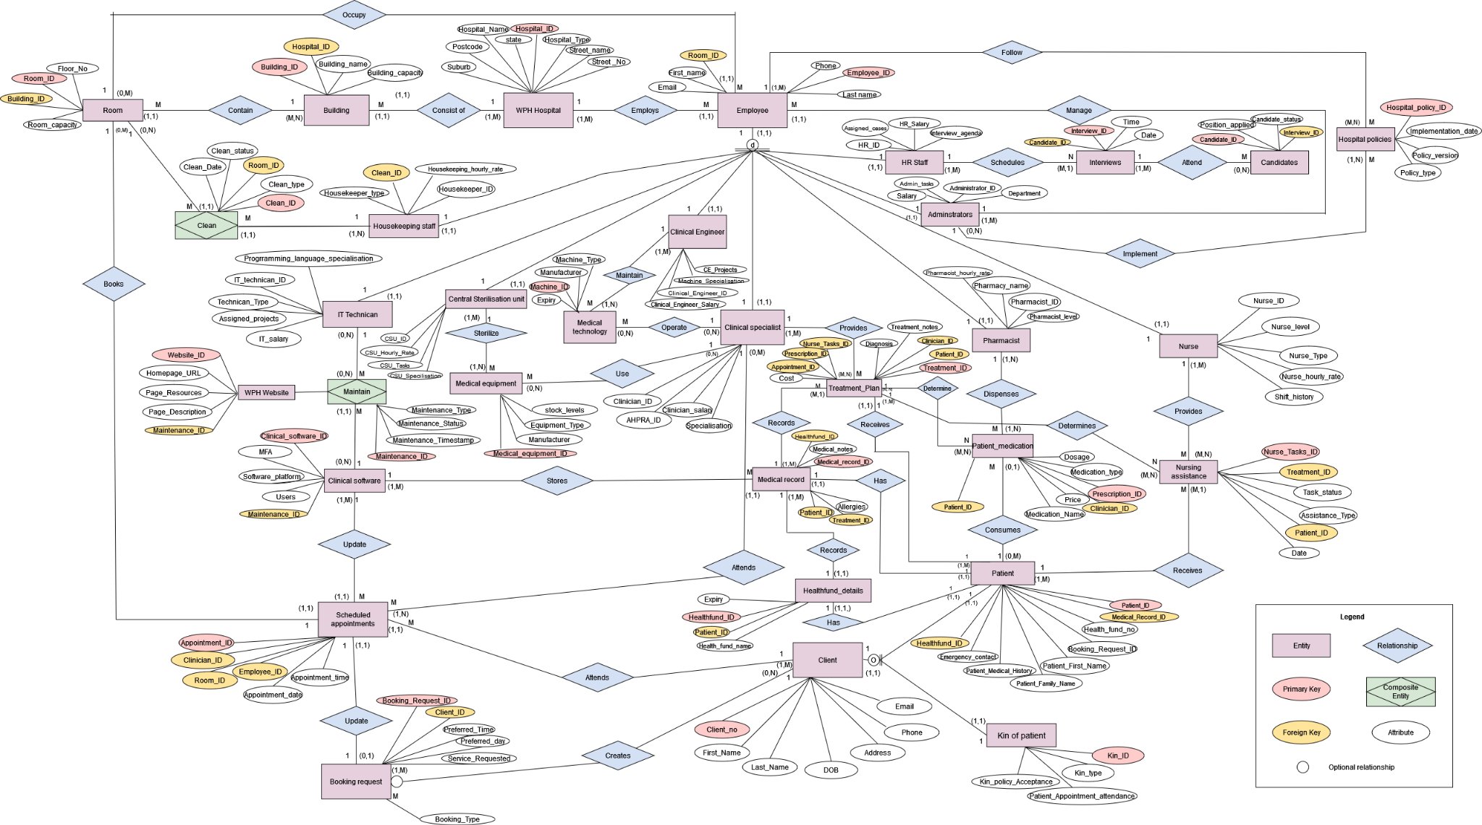
Entity Relationship Diagram (ERD)

Slide 4
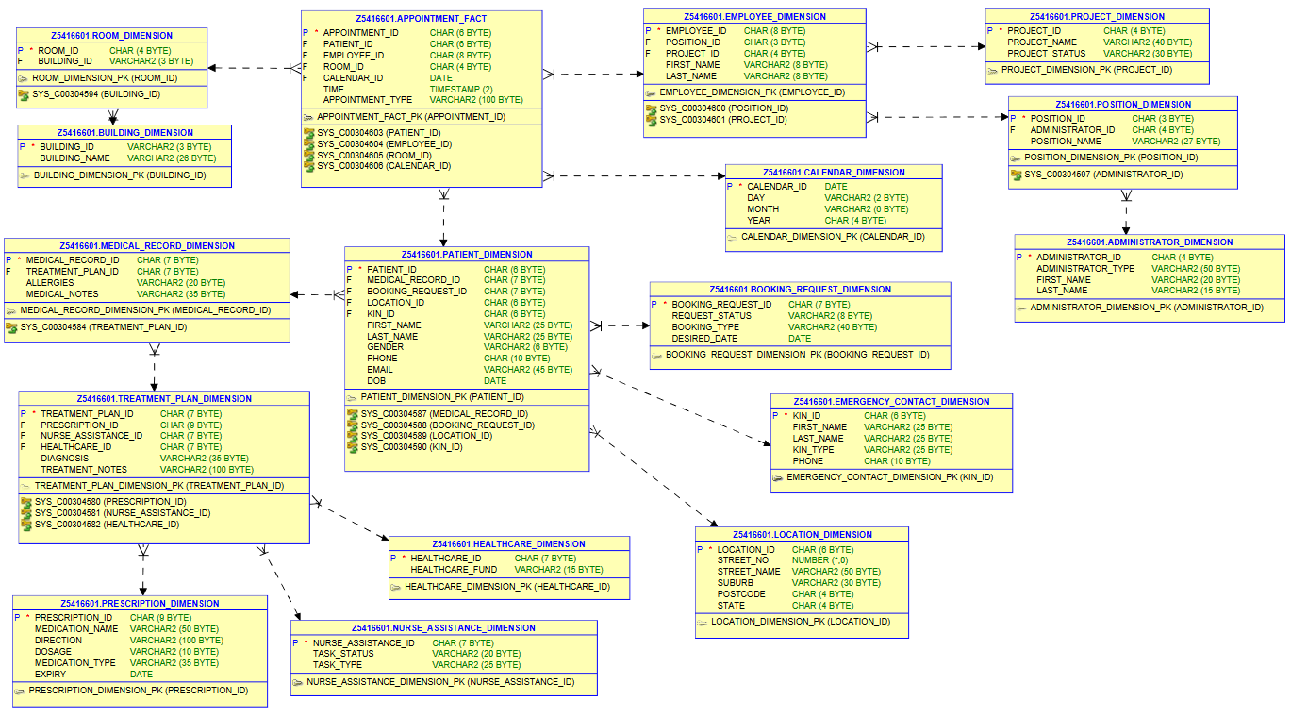
Snowflake Schema

Slide 5
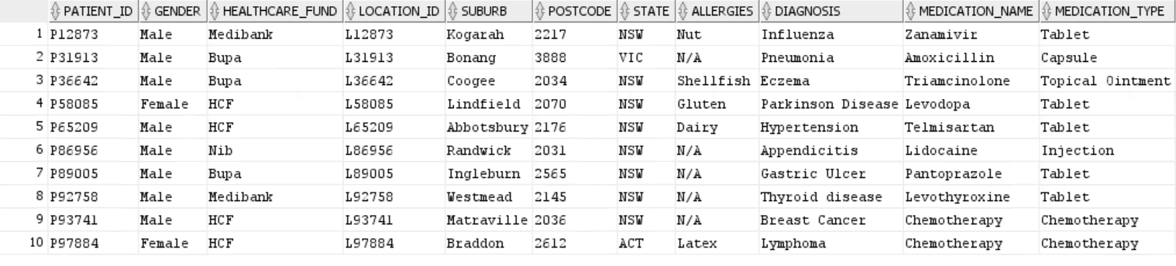
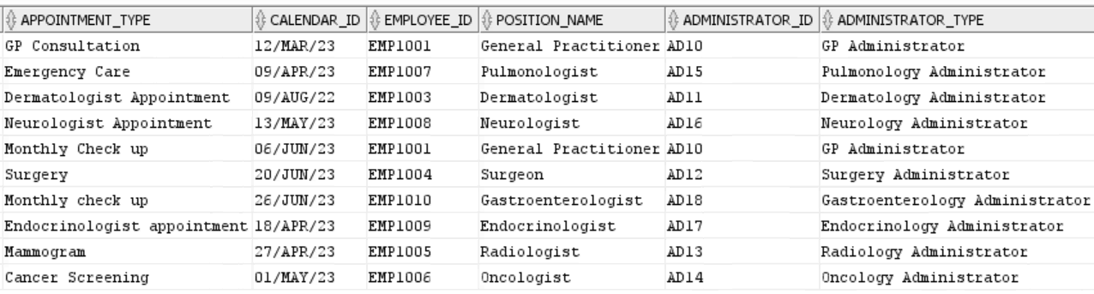
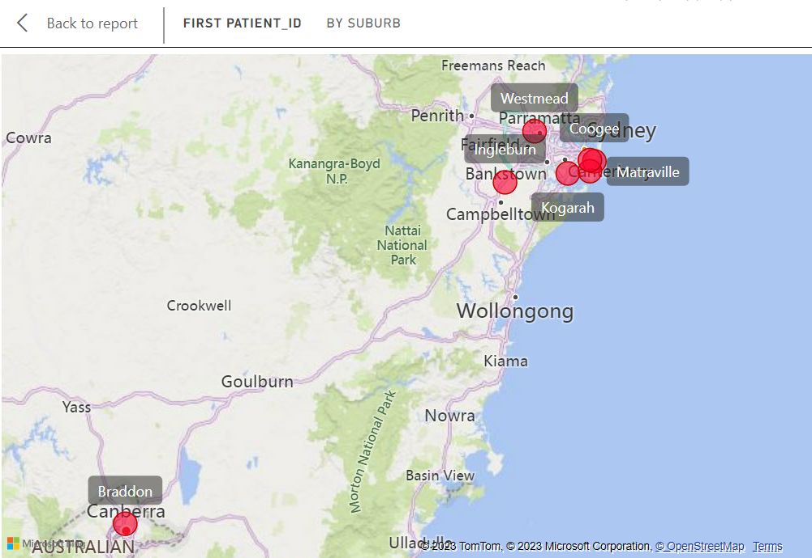
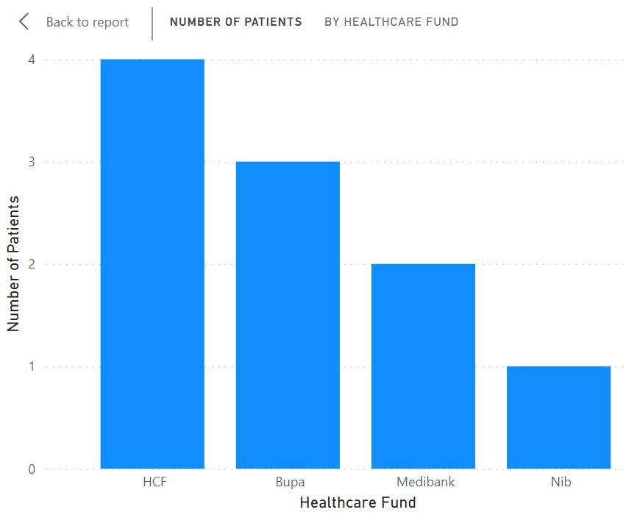
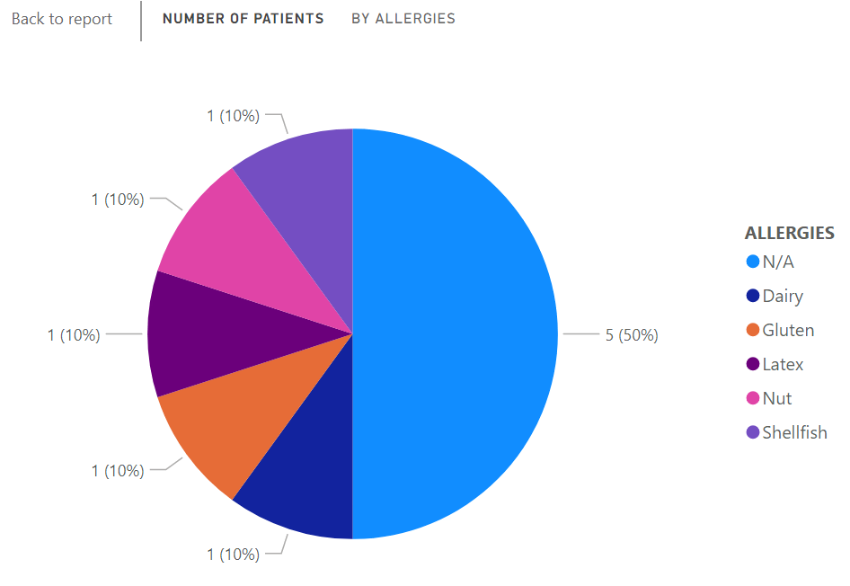

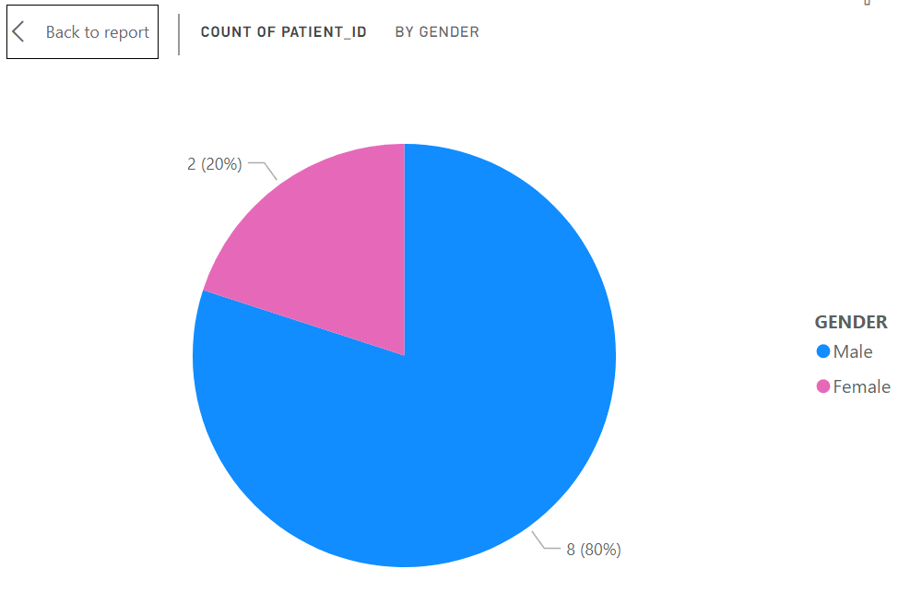
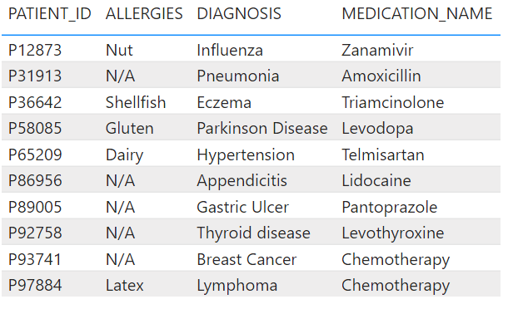
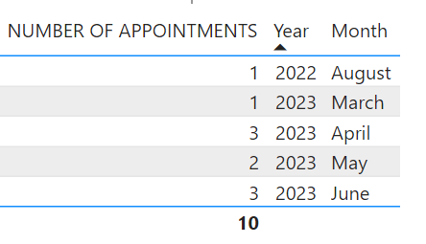
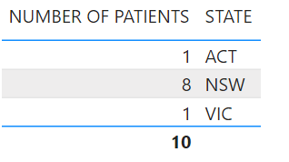
Materialised View & Data Analytics

Slide 6
Thank You.

